Slide 1

Web Systems Development Fall 2017
Team 5 - Haochang Qian, Stephanie Tan, Osama Minhas, Silei Tian, Omer Osman
Notes:
Silei

Slide 2
Team Introduction
HaoChang Qian
Tech Lead
Backend Developer
Stephanie Tan
Project Manager
Frontend Developer
Osama Minhas
Frontend/Backend Developer
Omer Osman
Backend Developer
Tester
Silei Tian
Backend Developer
Notes:
Every man for themselves

Slide 3
Project Goals
Give RPI students access to a system for easy sharing, exchanging, and requesting notes and books
Provide study resources and academic support to aid students at a very rigorous school
System organized by different classes and majors for easy access to specific information
Students have the option to sell notes or provide free notes, resources or guidance
Implement a chat board feature for students to get immediate help
Notes:
Silei

Slide 4
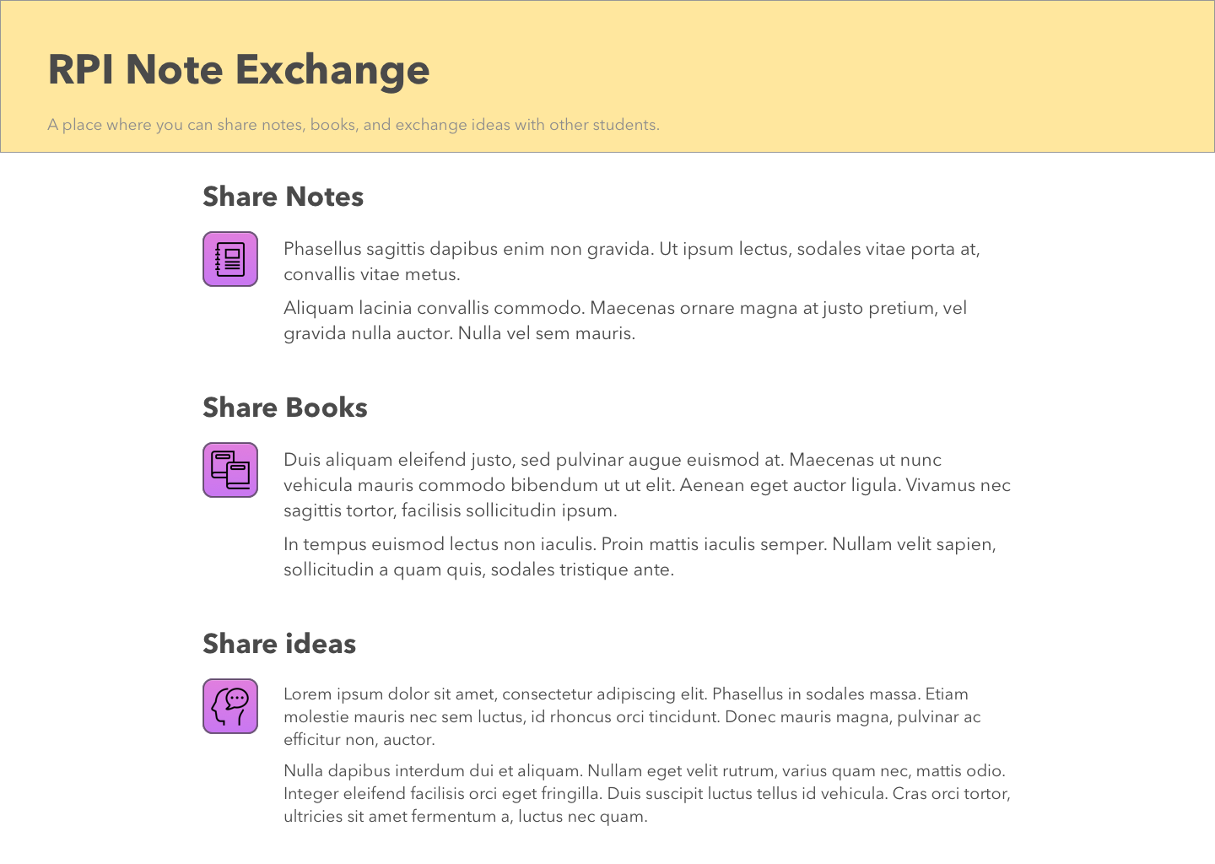
Home Page Mock-Up
Notes:
Omer

Slide 5
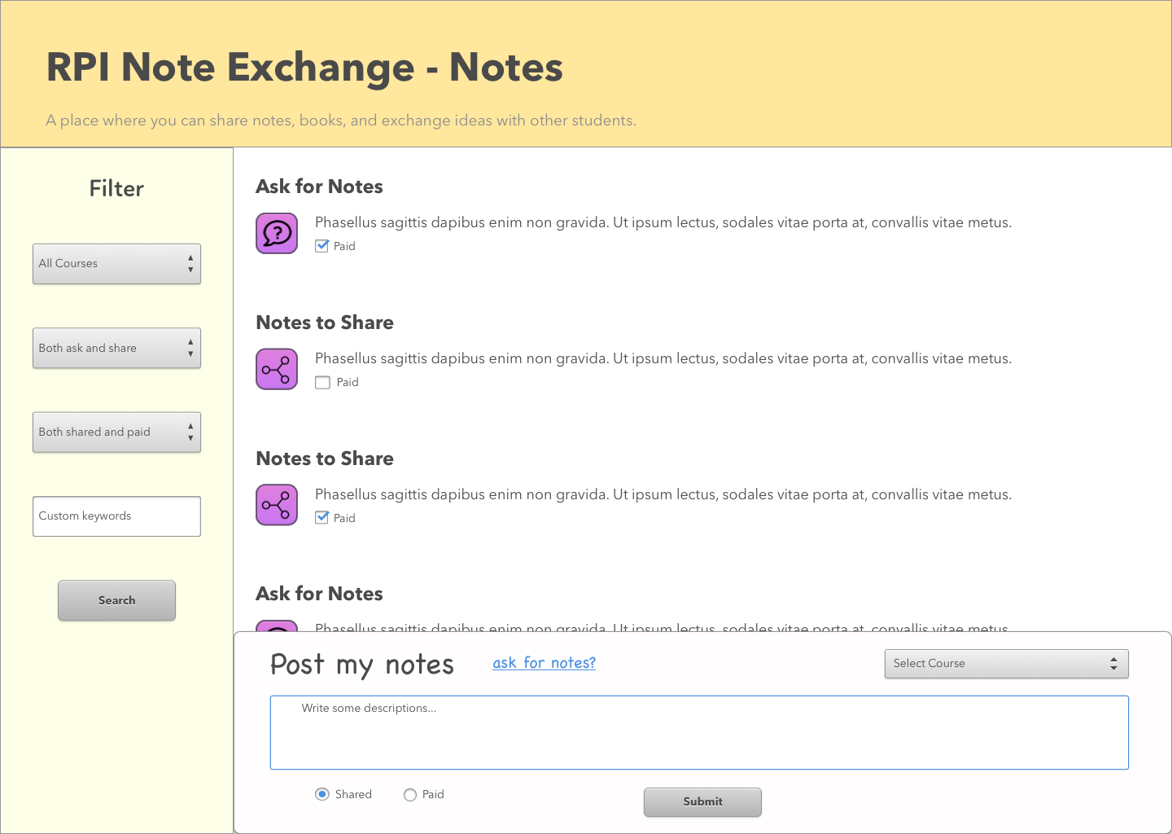
View / Post Page Mock-Up
Notes:
Omer

Slide 6







Implementation
Laravel (PHP)
Composer
PhpMyAdmin
MySQL Database
PDO Migrations
HTML/CSS
Bootstrap
Javascript
jQuery
Notes:
Omer

Slide 7
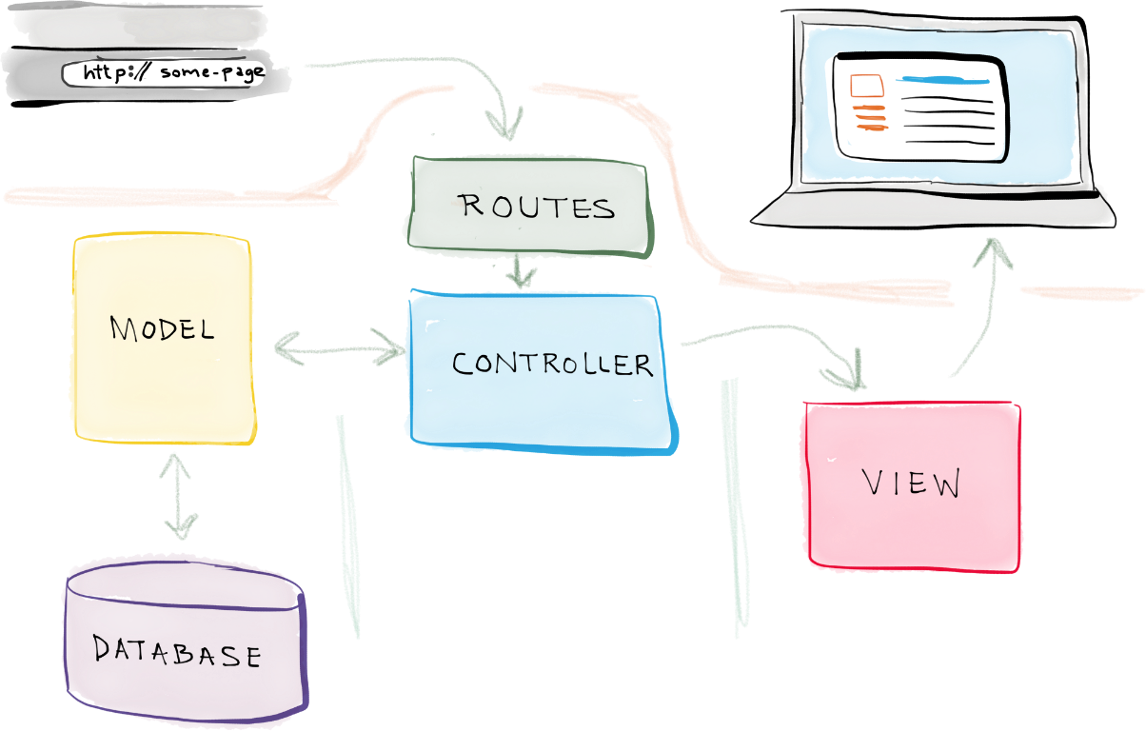
Laravel
Open Source PHP Web Framework
Focuses on Models/Views/Controllers
Controllers manage back-end functions
Views handle front-end
Notes:
php is kind of complicated and chaotic when constructing the whole website, because it focuses more on the backend, and not that easy when handling front-end stuff, because you have so much things like database, links, http requests and responses. But if we use laravel , things come straightforward. “Eloquent” elegant!

Slide 8
Security Features
SQL Protection
Password (bcrypt hashing) Encryption
Cross-site scripting prevention
CSRF Protection (Cross Site Request Forgery)
Permissions
Notes:
HaoChang

Slide 9

Demo
Enjoy!
http://129.161.48.165:2333
please be kind to my computer/server!
Notes:
Stephanie

Slide 10
Challenges
Learning a new framework
Many files
Learning GitHub
Different levels of knowledge
Scheduling/coordinating meeting times
Time Management
Technical difficulties
Notes:
Laravel was something that most of us have not used before so we learned
GitHub was essential to the project, but also took getting used to.
We all have different academic schedules and therefore had difficulty finding time to meet and work on the project, but we managed.
With the use of new frameworks and software not everyone was familiar with, there were technical difficulties in setting this software up on all of our devices.
There were many files that needed to be worked with and needed altering to ensure proper implementation.
The project was sometimes more time consuming than we anticipated because of unexpected technical difficulties that arose and with complications with coding using the new software.

Slide 11
Next Steps
“Resolve” posts/requests for notes
Have more details on the classes within majors
Be able to “Follow” classes
Use Vue js or Angular Js to implement the front-end lazy loading
Notes:
Osama

Slide 12
Thank you!
Questions?
Thanks for an amazing semester Ahmed!
Notes:
🤔

